Slide 1
Aircraft Landing Simulation System
Team 7
- Lokesh Paduchuri
- Nikhil Joshi
- Raghuvinoth R Sundaresan
- Shravan Kokkula

Slide 2
ComputeSimulationState Class Inputs & Expected Outputs
Test case Inputs: Speed, Gear Down, Altitude, Time.
Test Case Outputs: Gear Not Down alarm, Gear Air Speed alarm, Air Brake warning, Gear Override warning, Gear-up command, Silence Alarm.

Slide 3
ComputeSimulationState Execution

Slide 4
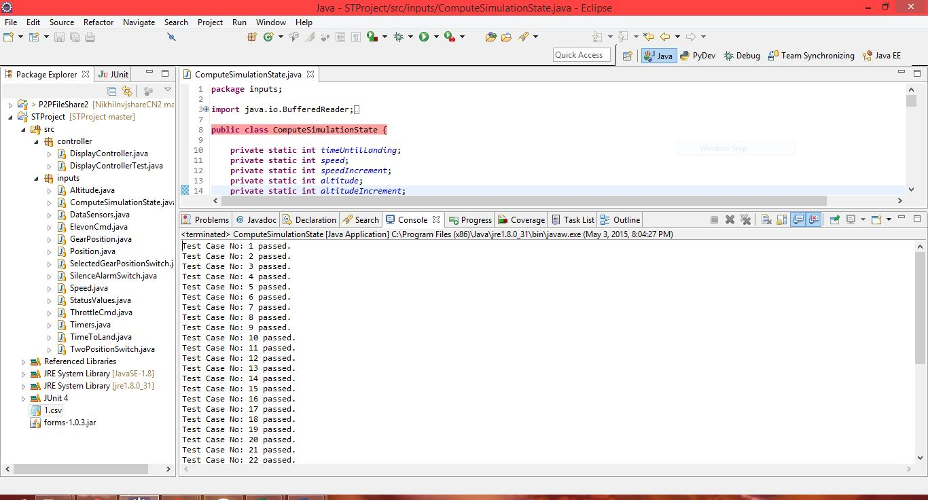
ComputeSimulationState Class Console Output.

Slide 5

ComputeSimulationState Class Console Output contd..

Slide 6
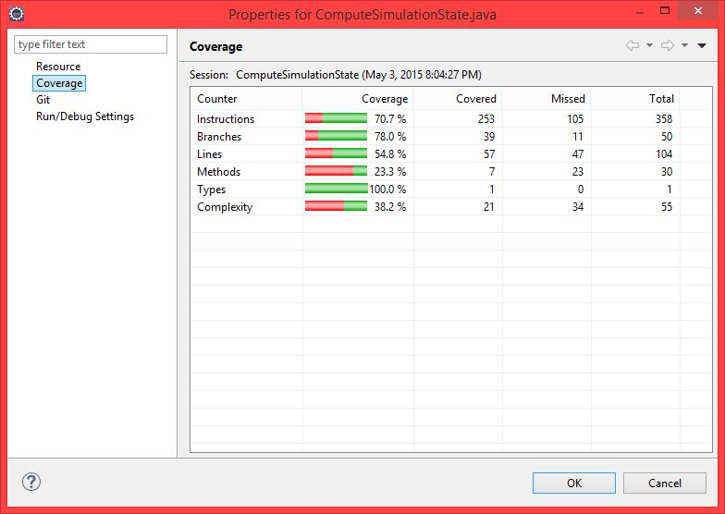
ComputeSimulationState Class Coverage Summary

Slide 7
DisplayControllerTest Class
Test case Inputs: Speed, Gear Down, Altitude, Time
Test Case Outputs: Gear Not Down alarm, Gear Air Speed alarm, Air Brake warning, Gear Override warning, Gear-up command.

Slide 8
Display Scenarios Test Oracle Table
Display Scenario | Speed | Gear Down | Altitude | Time | Gear Not Down alarm | Gear Air Speed alarm | Air Brake warning | Gear Override warning | Gear-up command
1 | 249 | N | 1500 | 59 | X
2 | 401 | N | 1500 | 59 | X |  | X
3 | 401 | Y | 1500 | 59 |  | X | X | X | X
4 | 401 | Y | 1500 | 121 |  | X |  | X | X
5 | 301 | Y | 1500 | 59 |  | X | X
6 | 301 | Y | 1500 | 121 |  | X
7 | 250 | Y | 1500 | 59 |  |  | X
8 | 415 | N | 1025 | 130

Slide 9
DisplayControllerTest Execution

Slide 10
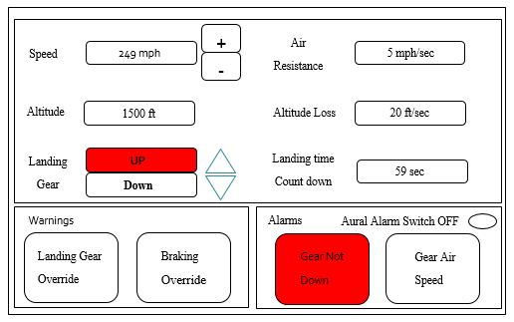
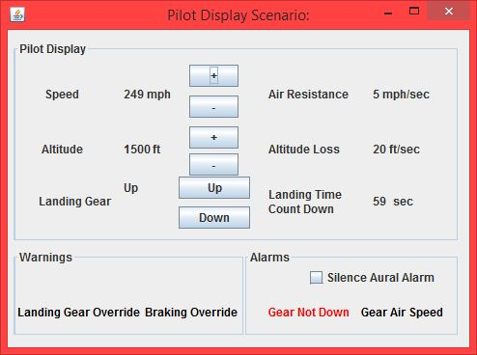
Display Scenario 1

Slide 11
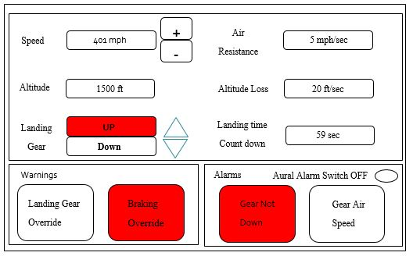
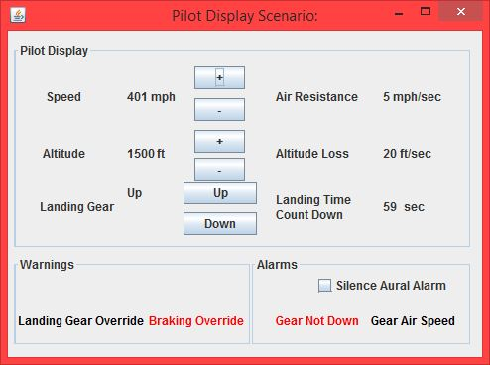
Display Scenario 2

Slide 12
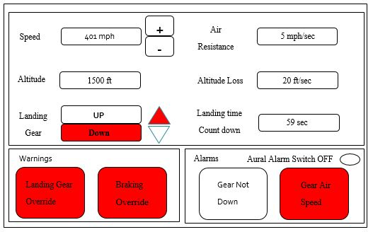
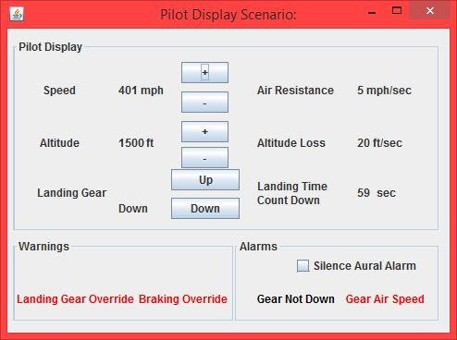
Display Scenario 3

Slide 13
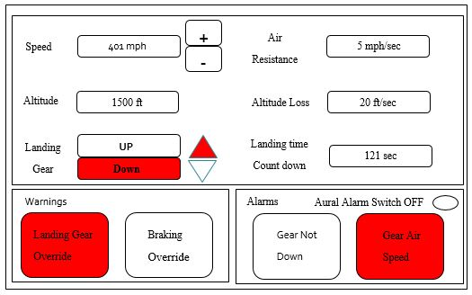
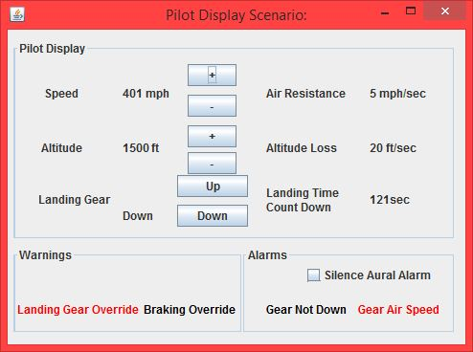
Display Scenario 4

Slide 14
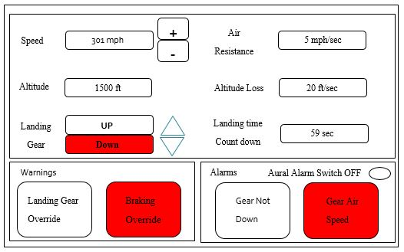
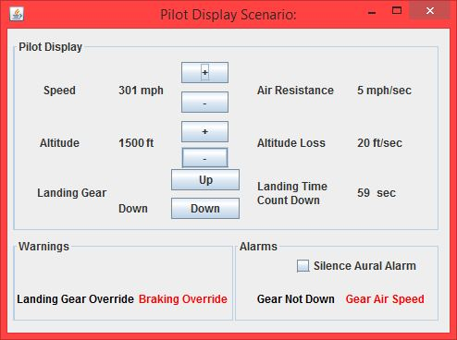
Display Scenario 5

Slide 15
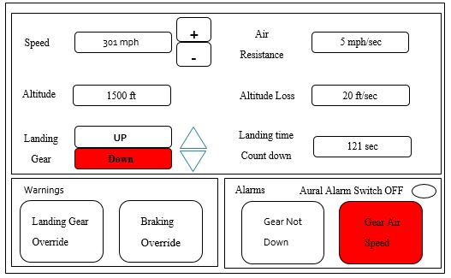
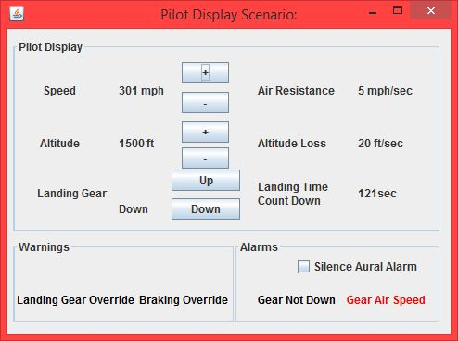
Display Scenario 6

Slide 16
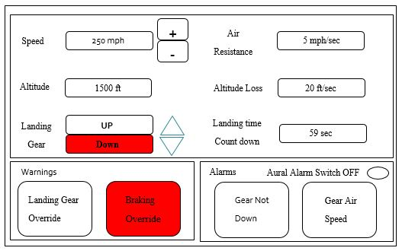
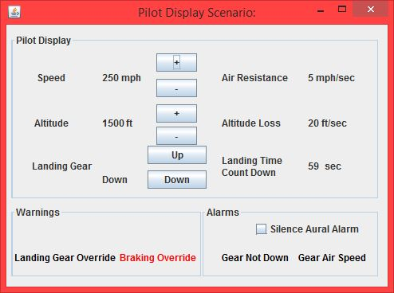
Display Scenario 7

Slide 17
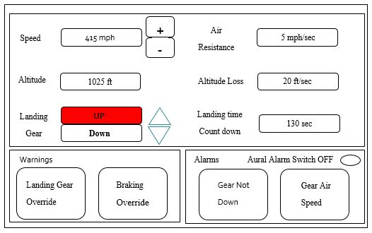
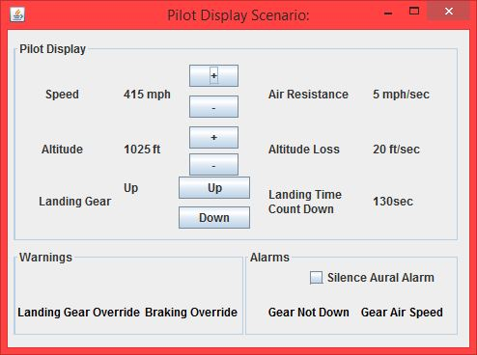
Display Scenario 8

Slide 18
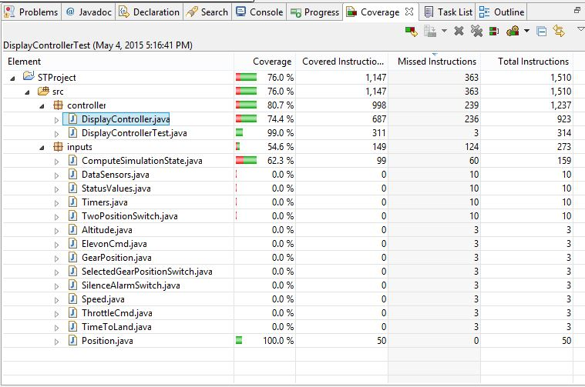
DisplayControllerClass Coverage Summary

Slide 19
Demo of working Aircraft Landing Simulation System

Slide 20
Functionalities of system
Altitude reduces by 20ft, speed decreases by 5 miles/sec and time per sec.
At TimeUntilLanding = 0 and speed =0 and altitude = 0
and GearPosition = Down Result =‘Landed’.
TimeUntilLanding! = 0 OR speed! =0 OR altitude! = 0
OR GearPosition! = Down Result =‘Failed’.
Pilot can increase/decrease speed and altitude to safely landed plane,
When gearPosition = Down and speed > 400 then, Landing gear is automatically overrided to change gearPosition = Up.
When AirBrake Warning is active, speed >250, speed is decreased by 10mph

Slide 21
Thank You.

